Slide 1
Quality in E2E
26 September 2019

Slide 2
E2E Systems
US - AMER
LATAM
CANADA
EMEA /APJ
Online
Offline
Online
Offline
Online
Offline
Online
Offline
Dell.com
CS
B2B
P+
DSA
Dell.com
CS
B2B
P+
LA-DOMS/
USP
Dell.com
CS
B2B
P+
CA-DOMS
Dell.com
CS
B2B
P+
Gii
DPID / IRN
DPID / IRN
DPID / IRN
DPID / IRN
GCMP
GCMP
GCMP
GCMP
Omega Order No
Omega Order No
DOMS Order No
DOMS Order No
Gii Order No
Omega
Omega
Omega Order No
Omega Order No
OCI
OCI
Order Status Updates
Sales Order No
AMF Order No
AMF Order No
Sales Order No
OFS
Order Status Updates
Global Prod Order
Carriers
B2B
(GXS)
BOSS
FOOE
GOLF
B2B
(GXS)
Carriers
WO
Status
VPO Work Order
3PL Work Order
WO
Status
Factories/ODM’s
3PL’s
UDM
Glovia
OCI
Planning & Procurement Systems
SCDH
FSL/FDL
BILL / SDR
DELTA
Store Order details
Generating Invoice

Slide 3
Product Data Hierarchy

Slide 4
Product Data Structure
LOB – Line of Business
Brand
Family
Chassis
Module
Option
SKU
MOD
PARTS

Slide 5
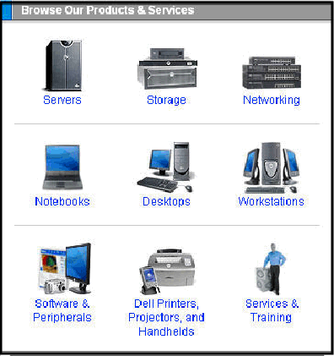
Product line / LOB
The highest level of the Sales Product Data Hierarchy, Product Line helps the customer make their first decision about the product they wish to purchase. EXAMPLE: Desktops, Servers, Notebooks, etc.

Slide 6
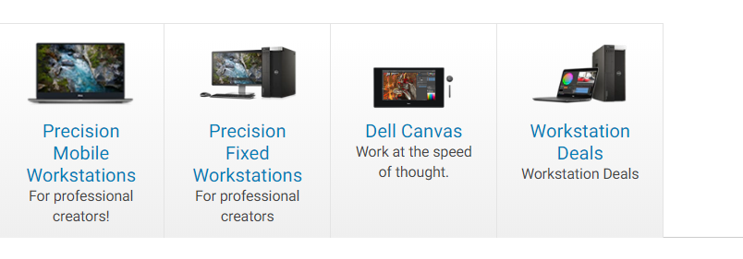
BRAND
The next level used for online grouping of products within a Product Line, Brand allows a customer to narrow their product selection. Brand also enables marketing flexibility by allowing the use of Manufacturing and Sales business rules to be applied to this level. Example: Dimension, Optiplex, Precision, Latitude etc.

Slide 7
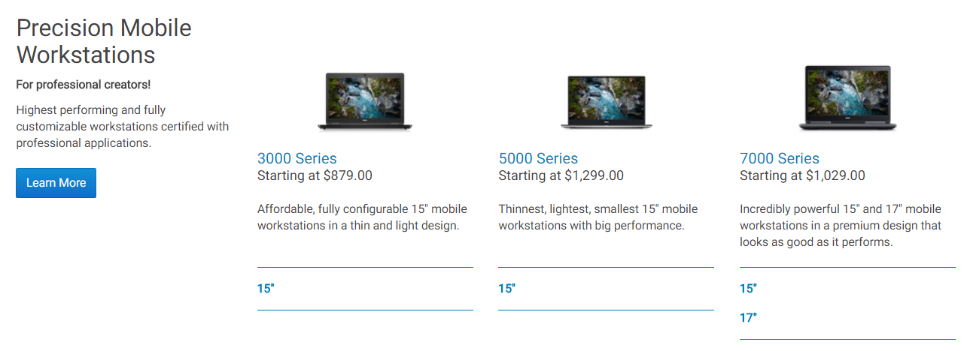
FAMILY
GCM's role for Family is similar to it's role for Brand. In addition to setup of Families in Dell's Order Entry systems, GCM also creates Manufacturing and Sales rules to ensure that ordred products are buildable. Example: Dimension Brand Families: 2400, 3000, and 4600

Slide 8
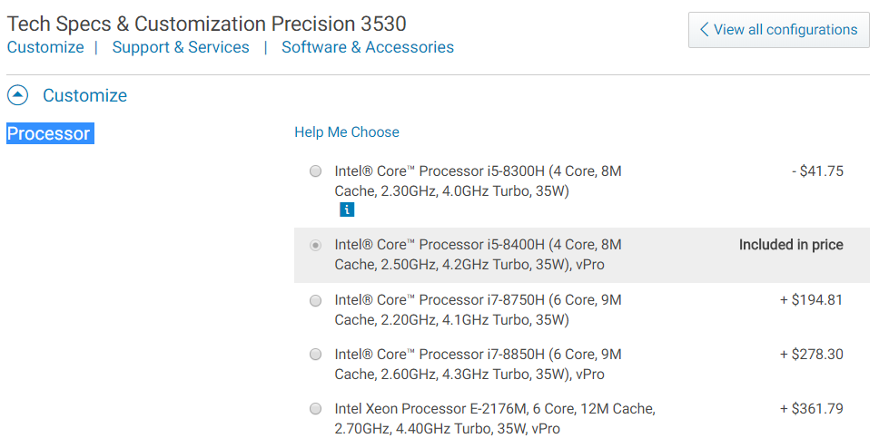
Module
BASE MODULE is always module 1 in a chassis configuration and contains the BASE which is: the unique item (SKU) that lives behind
the unique option (Legend Code) that lives in
the unique first module (Base Module) that lives in every system sold by Dell.
Processor is a Module

Slide 9
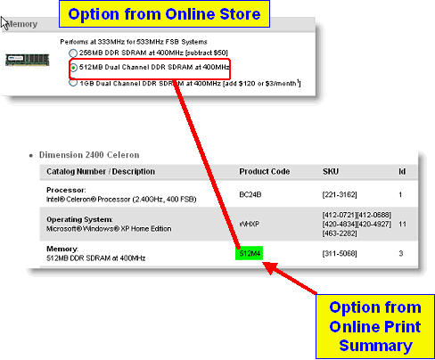
Options
Options (Legend Code) Options are subsets of Modules (see above) and are used to group SKUS together.
Options are more specific than Modules therefore they offer more flexibility to sales.
The picture below shows an Option selected on the Dell Online Store. Notice the Option Number appears on the customer's print summary once selected.

Slide 10
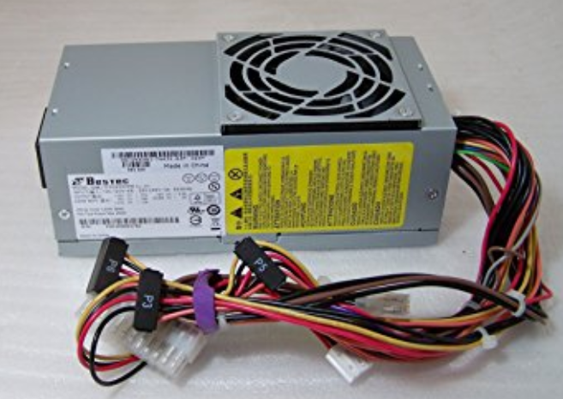
SKU
At Dell, SKUs are Sellable, Kittable Units with three important characteristics:
price
cost
sales status by segments.
SKUs represent a set of related parts/Builds of Material (BOM). Trying to order a list of parts would be difficult for Dell customers and Sales personnel. SKUs provide ease of use in ordering.

Slide 11
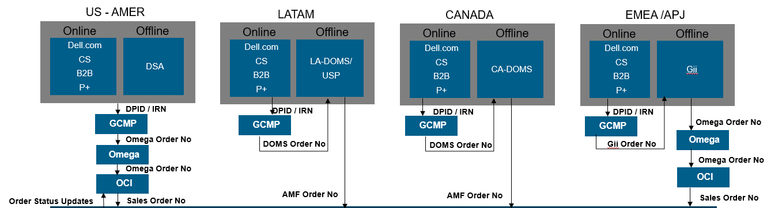
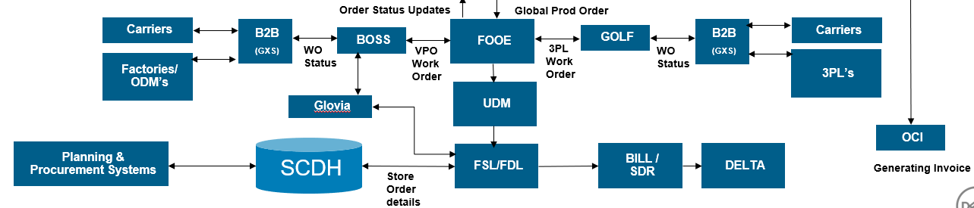
E2E Data Flow

Slide 12
Fulfillment & Logistics Data Flow

Slide 13
Thank you
Questions?

